Slide 1


CYRIX HEALTHCARE PVT LTD
Insert the Sub Title of Your Presentation

Slide 2
A BRIEF STORY
Its been an expertise in the field of Medical Equipment's and consumables since 2004.
Maintaining our service and quality standards for more than a decade.

Slide 3


A team of aspiring individuals performing multi-tasking operation in medical industry Sales, Service, Spares, Testing and Calibration, Training & Development, Exporting of Medical Equipment & Consumables of all brands/makes.
Satisfaction

Slide 4

Our Vision
Our Vision is to meets the needs of medical –health care sector through the provision of medical equipments and materials by ensuring safety and welfare of patients.
.

Slide 5

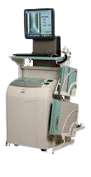


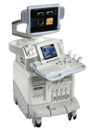


Milestone
Authorized Fujifilm –CR & DR System Sales & Service Dealer in Kerala
Started with Medical Equipment service centre
Awarded as Fastest Growing Co. National award
2004
2009
2015
2007
2013
2017
Authorized Mindray-Ultrasound Scanning Sales &
Service Dealer in Kerala
Expanded our operation of service activity to
Tamil Nadu.
Started operations in U.P.-AERB Project
Expanded our operation of sales & service activity to Karnataka.

Slide 6

Milestone
Expanded our operation of service activity to
Dubai.
Started operations in Maharashtra AERB Project
Expanded our operation of service UP-BEMP Project
2018
2020
2019
Expanded our operation of service activity to Kuwait.

Slide 7
Key Features
320+
Staff Strength
7
Span of Control
5 states in India and 2 international operations
8000+
Customer Installation Base

Slide 8
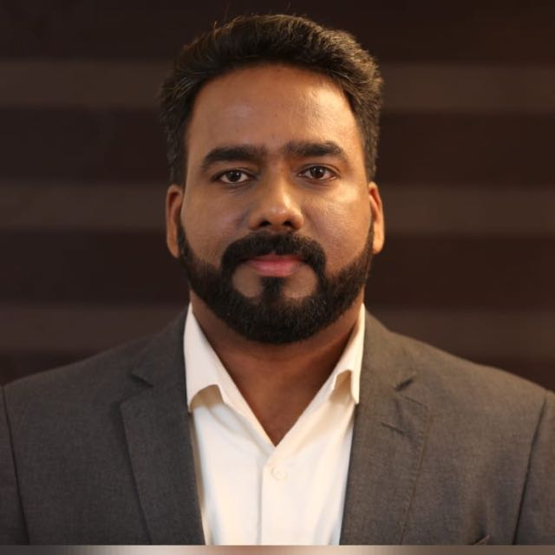
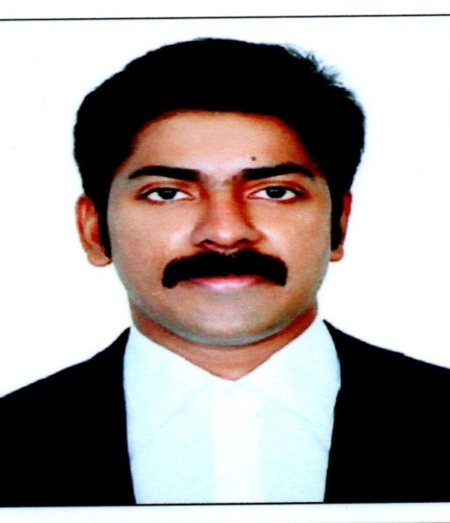
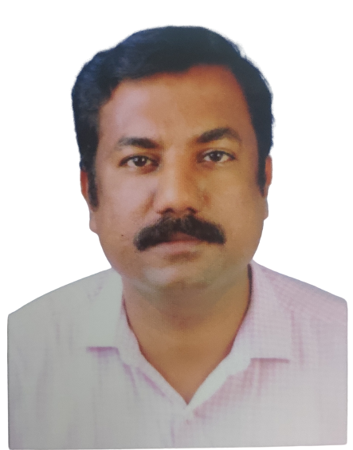

Board of Directors
Mr.Joymon K John
Director
Expertise in the field
for 18 years
Mr.Ajith Kumar S
Director
Expertise in the field
for 20 years
Mr.Prathesh Joseph
Additional Director
Expertise in the field
for 21 years

Slide 9
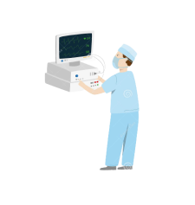

01
Biomedical Equipment Sales Department
02
Biomedical Equipment Service Department.
CYRIX
HEALTHCARE PVT LTD
03
Biomedical Equipment Hands-on Training
04
Medical Device Testing and Calibration Department
05
QA of Radiological Equipment
06
Biomedical Equipment Maintenance Program
07
Mobile Medical Ambulance Survillenance Services

Slide 10
Our Process
CYRIX HEALTHCARE PVT LTD
Hospitals/Clinics/
Diagnostic centre
CYRIX HEATHCARE PVT LTD

Slide 11

Hospitals/Clinics/ Diagnostic centre
EQUIPMENT SALES
CALIBRATION & QA OF EQUIPMENTS
Sales of various of medical
Equipment used in
Hospital Industry
.
Testing and Calibrating Medical Equipment as per ISO Standards
.
EQUIPMENT SERVICE
PROFESSIONAL EQUIPMENT TRAINING
Services of all kind
of medical Equipment
used in Hospital Industry
Advanced Hands-on Training
for Biomedical Professionals
and beginner for various
major and minor equipment
Used in Hospital .

Slide 12


Slide 13
SPAN OF CONTROL
INDIA
Kerala
Tamil Nadu
Karnataka
Uttar Pradesh
Maharashtra
UAE
Dubai
Kuwait

Slide 14








OUR ASSOCIATIONS

Slide 15




Our Certification
NABL Accredited Calibration Agency .
We are India’s 3rd and South India’s 1st NABL
Approved Medical Device Service Agency
AERB Certified Q.A. agency

Slide 16
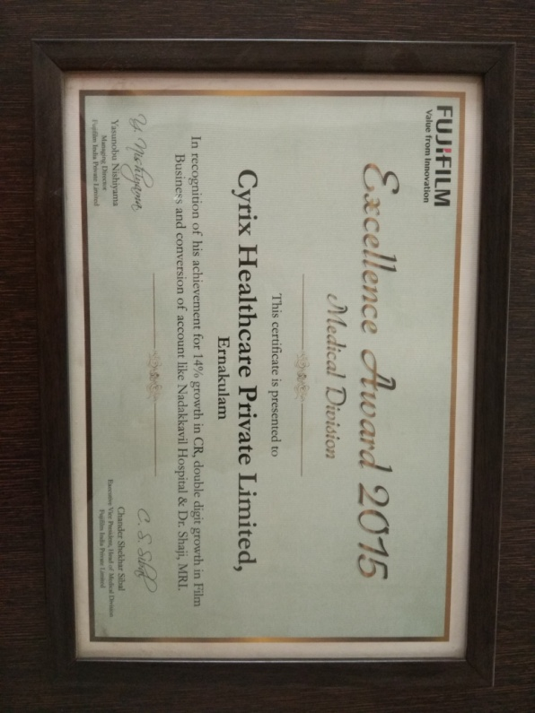
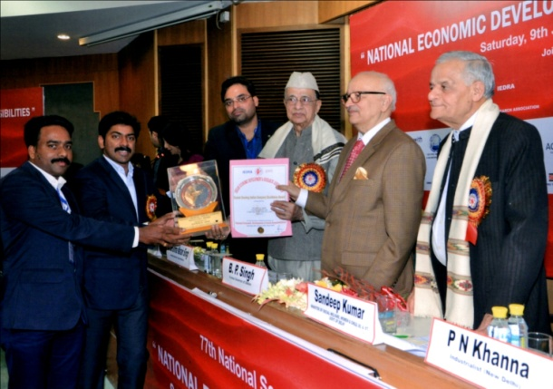
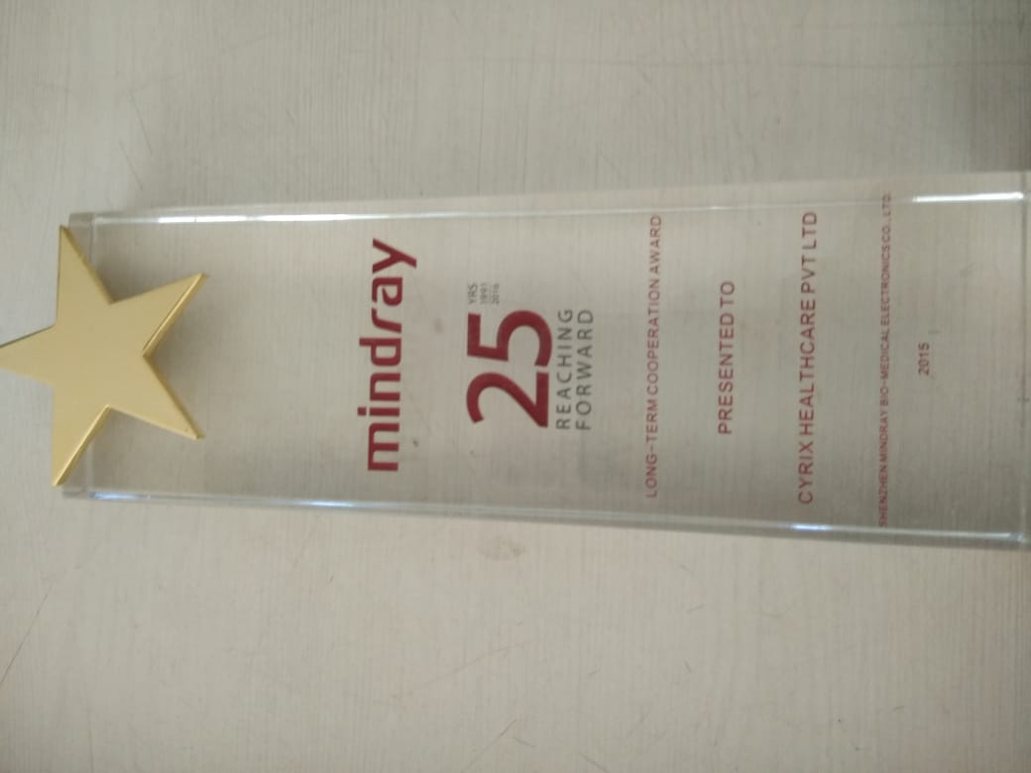
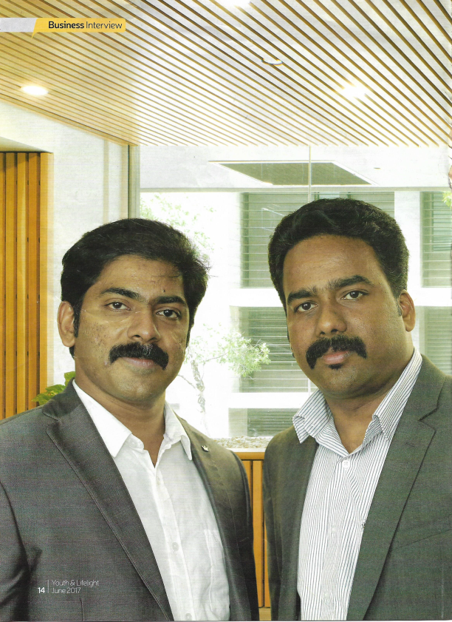
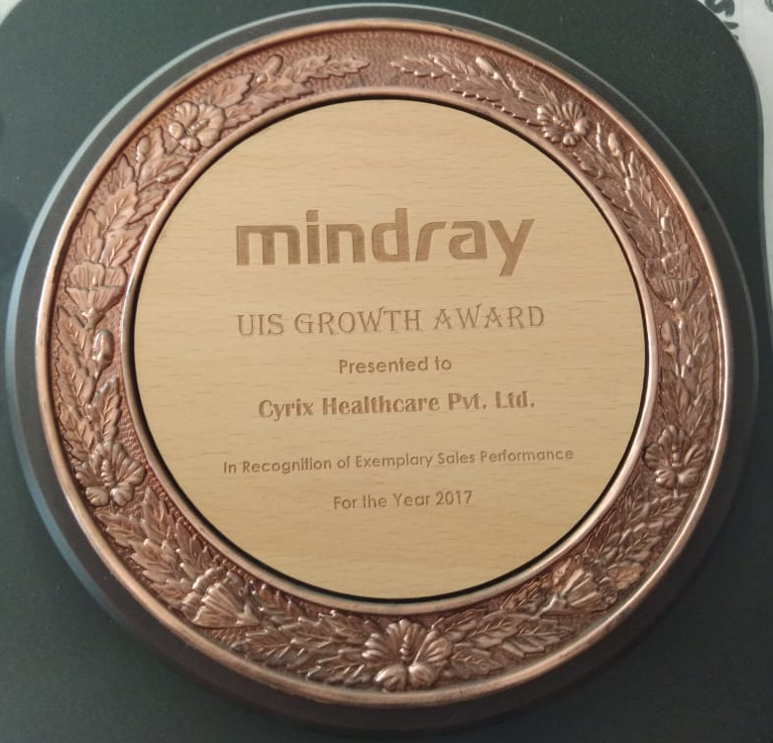
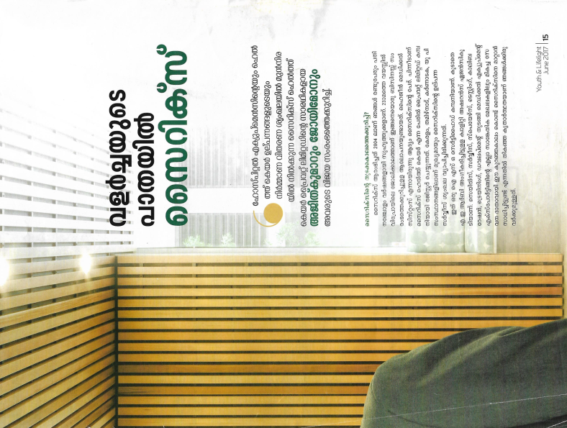
Recognition

Slide 17
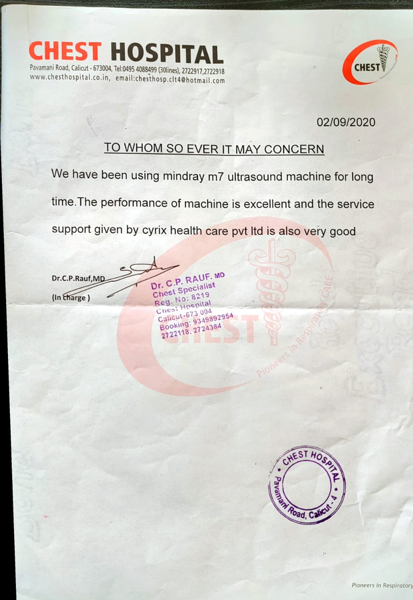
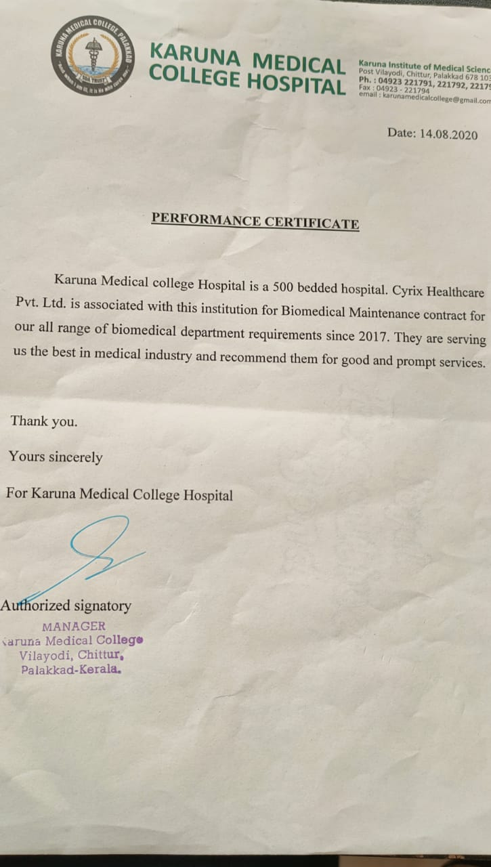

Slide 18
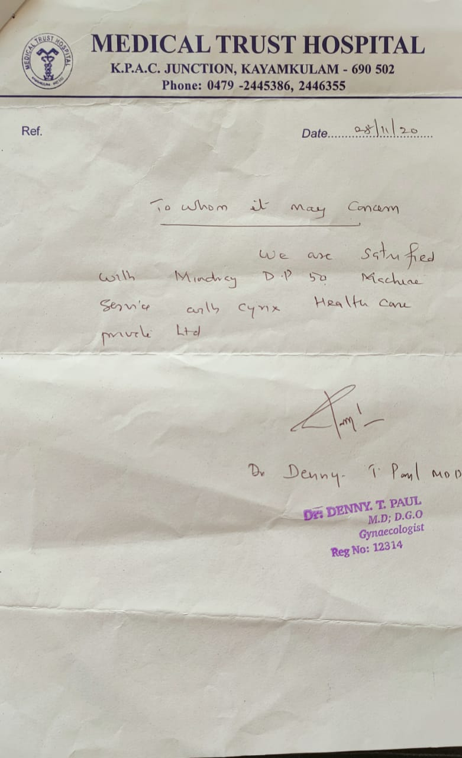
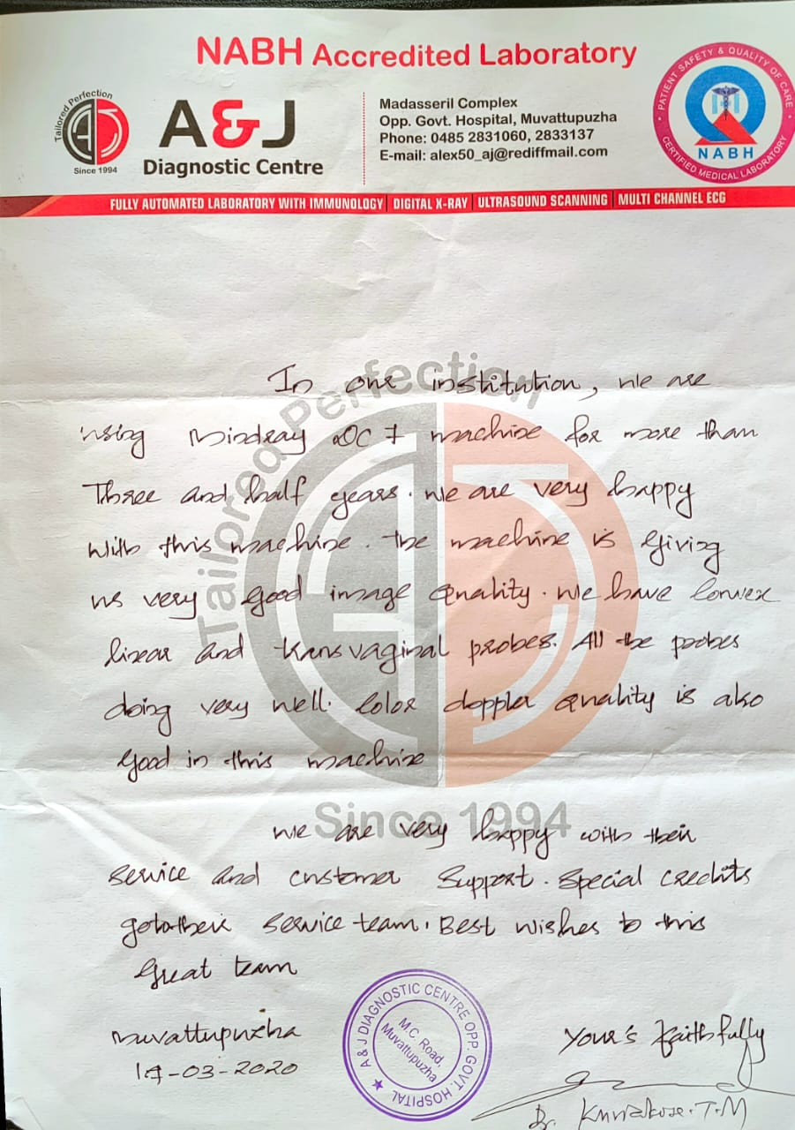

Slide 19
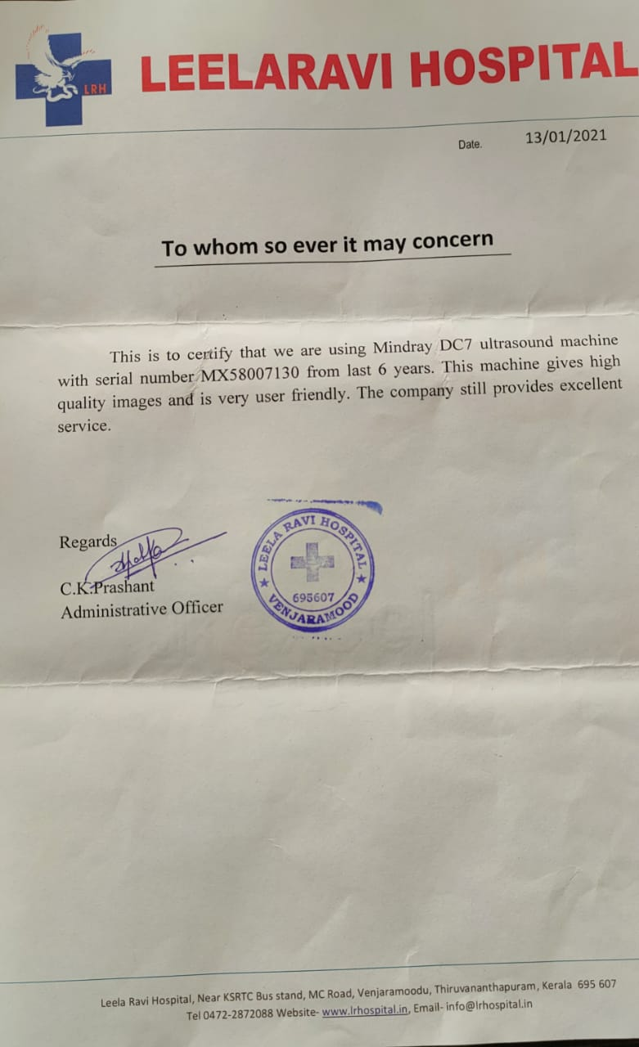

Slide 20
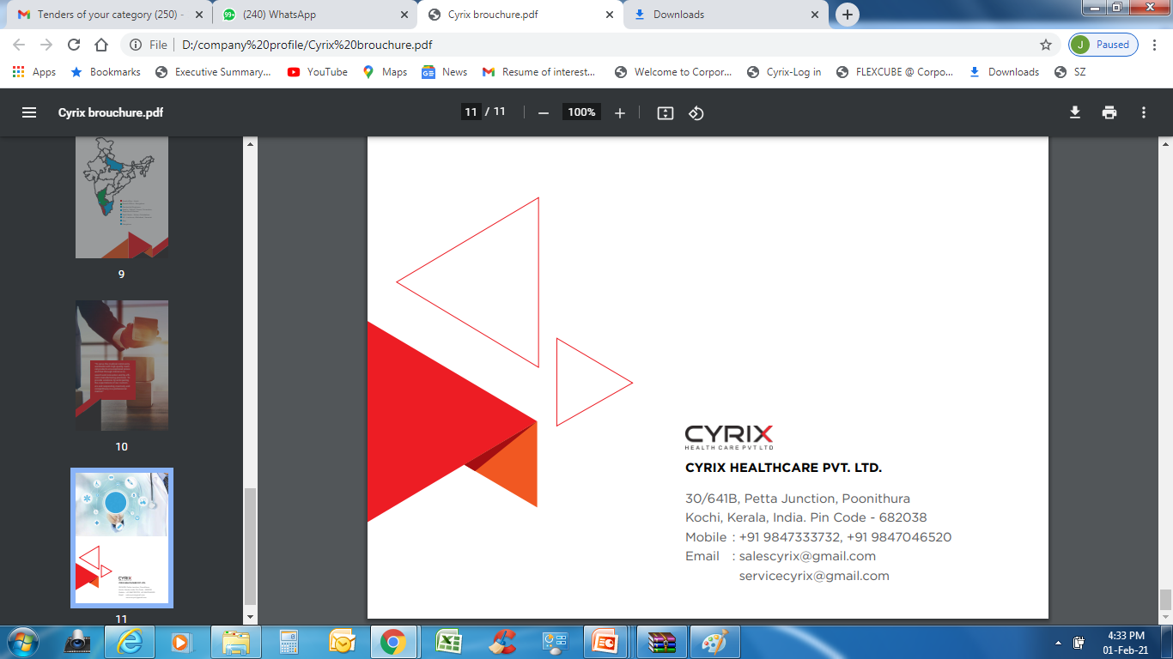
CONTACT US……

Slide 21










Thank You
Insert the Sub Title of Your Presentation

